Slide 1
Natural Language Understanding
Natural Language understanding requires lexicon, parser and grammar rules to understand internal representations.
NLU is used to find the intent and entity from plain text.
NLU is sub-part of Natural Languages Processing and covers comprehension part.

Slide 2
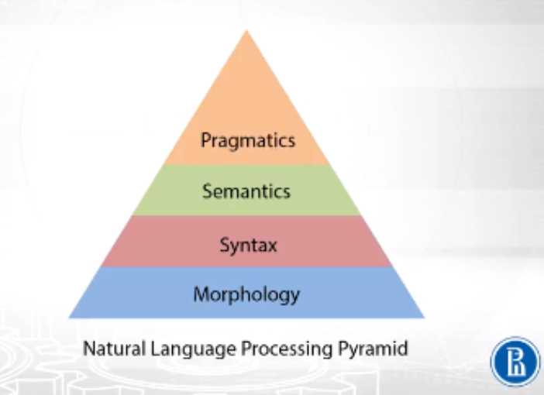
Understanding of language

Slide 3
Language Processing
Level 1 – Speech sound (Phonetics & Phonology)
Level 2 – Words & their forms (Morphology, Lexicon)
Level 3 – Structure of sentences (Syntax, Parsing)
Level 4 – Meaning of sentences (Semantics)
Level 5 – Meaning in context & for a purpose (Pragmatics)
Level 6 – Connected sentence processing in a larger body of text (Discourse)

Slide 4
Morphology
In this level, words are formed from complete sentence. Tokens are created by the use of lexical analyzer in this level.
Morphemes are generated during Morphology.
Free morphemes are used as single word e.g. eat, drink etc.
Bound morphemes are used as prefix or suffix e.g. –s in books ,re- in redo.
Which is best University in Dehradun?
‘Which’
‘is’
‘best’

Slide 5
Syntax level
Syntax is the set of rules which are used to form a sentence in any language. There must be certain order maintained by words to avoid violation of syntax rules of grammar.
E.g - I book a flight or I flight a book.
I am student of UPES or I am UPES of student
NLP is very interesting subject or NLP is very subject interesting.

Slide 6
Semantics
The meaning of sentence is found in this level.
E.g ‘google’ something on Internet or Google is search engine.
E.g. hot ice-cream.
I went to bank. I went there to withdraw money.

Slide 7
Discourse level
In this level, dependency of sentences on previous or after sentences is anlayzed.
E.g. I am student of B.Tech. This course is of 4 years duration.

Slide 8
Pragmatic level
In this level, context of sentences is formed.
E.g. I am student of B.Tech. This course is of 6 years duration.
This example clearly shows that context or scope of this sentence is about B.Tech course of educational institution.
I am student of B.Tech. This course is of 6 years duration

Slide 9
Evaluating NLU models
Every applications evaluation parameters are different. The general concept is it should assign more weightage to most occurring word and grammatically correct word.
Accuracy is improved with the increase in training dataset scale.
Best evaluation method is to put model on some task and evaluate the performance.

Slide 10
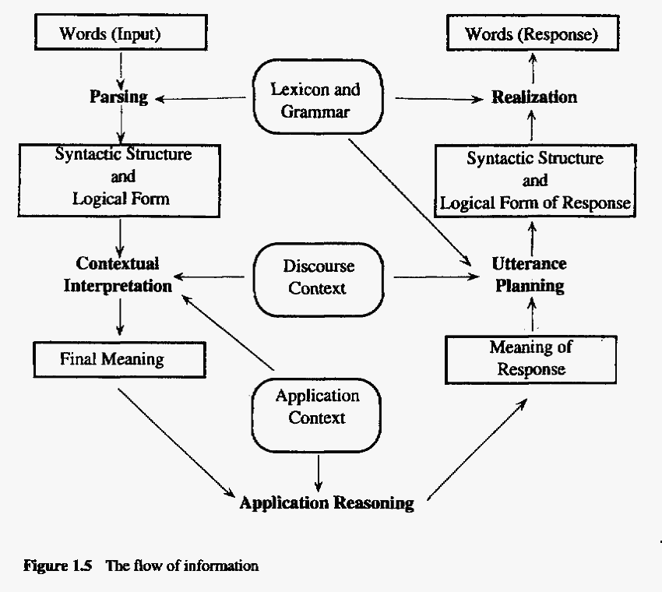
Steps

